Slide 1




KS4 Mathematics
S9 Imagining Paths and Regions

Slide 2
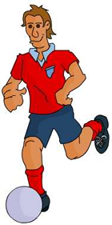

Imagining paths
A locus is a set of points that satisfy a rule or set of rules.
The plural of locus is loci.
We can think of a locus as a path or region traced out by a moving point.
For example,
Imagine the path traced by a football as it is kicked into the air and returns to the ground.
Notes:
Ask pupils to describe the path of the ball by sketching it or tracing the path in the air with their fingers.

Slide 3
Imagining paths
The path of the ball as it travels through the air will look something like this:
The shape of the path traced out by the ball has a special name. Do you know what it is?
This shape is called a parabola.
Notes:
Remind pupils that they have met parabola when sketching the graph of x².
Explain that a projectile is acted on by gravity. The physical laws governing the path of mean that the locus of points traced out will be parabolic. Other factors could alter this path such as air resistance.

Slide 4
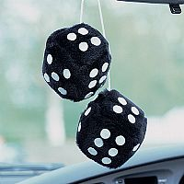
Imagining paths
A fluffy dice hangs from the rear-view mirror in a car and swings from side to side as the car moves forwards.
Can you imagine the path traced out by the dice?
How could you represent the path in two dimensions?
What about in three dimensions?
Notes:
Ask pupils to trace out the path using their finger tips or by sketching it. This path is similar the a sine curve.

Slide 5
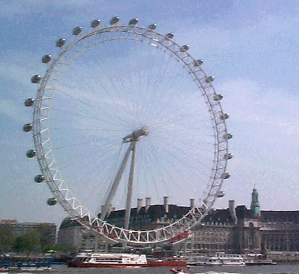
Imagining paths
A nervous woman paces up and down in one of the capsules on the Millennium Eye as she ‘enjoys’ the view.
Can you imagine the path traced out by the woman?
How could you represent the path in two dimensions?
What about in three dimensions?
Notes:
Ask pupils to trace out the path using their finger tips or by sketching it.

Slide 6
Imagining regions
Franco promises free delivery for all pizzas within 3 miles of his Pizza House.
Franco’s Pizza House is not drawn to scale!
3 miles
Can you describe the shape of the region within which Franco can deliver his pizzas free-of-charge?
Notes:
The region is a circle of radius 3 miles.

